Slide 1
Teaching in 2025: Transitions, Technology, and Teacher Empowerment
Generated by AgentFire AI

Slide 2

Executive Overview: Education Transitions in 2025
This slide presents a concise executive overview of the major transitions shaping teaching in 2025. It synthesizes the conference theme and practical trends so leaders and instructors understand the context for the remainder of the presentation. The Virtual Worlds Best Practices in Education 2025 theme of "Transitions" frames how virtual, AI-driven spaces and changing social dynamics are reshaping pedagogy. That guidance underscores that changes are not merely format shifts but deep redefinitions of roles for students and educators. Complementing that, professional commentary on teacher development emphasizes ongoing, differentiated professional learning approaches rather than one-off workshops.
Summarize the 2025 transitions framing and implications for policy
Emphasize students as creators and educators as facilitators
Identify professional development and system-level questions
Bridge conference theme to practical institutional priorities

Slide 3
Executive Overview: Education Transitions in 2025 (cont. 2)
Together these sources indicate a systemic shift toward student-created learning experiences, educator facilitation, and the use of technology to personalize instruction. This slide sets key questions for the audience: How can institutions support these shifts? Which teacher skills must be prioritized? What operational changes will sustain long-term transformation? The overview prepares the audience to examine specific implications for curriculum design, professional development, technology adoption, and equity initiatives in subsequent slides, linking conference-level framing to practical, implementable actions.
Summarize the 2025 transitions framing and implications for policy
Emphasize students as creators and educators as facilitators
Identify professional development and system-level questions
Bridge conference theme to practical institutional priorities

Slide 4

Theme Deep Dive: VWBPE 'Transitions' and Virtual Learning
This slide conducts a deep dive into the VWBPE 2025 presentation guidance and the implications of the "Transitions" theme for classroom practice and institutional strategy. The VWBPE 2025 Presentation Guidelines explain that educational transitions are reshaping how learners engage in virtual, AI-enabled spaces and that students are increasingly active creators of learning and social experiences. That perspective leads to concrete shifts: learning design must support student-generated content, global collaboration, and multimodal literacies. For administrators, the guidance signals a need for governance structures that permit experimentation in virtual spaces while prioritizing learner safety and equity.
Explain VWBPE 2025 'Transitions' framing and practical meaning
Recommend governance changes for virtual learning experimentation
Advocate co-design of learning experiences with students
Propose resource shifts to instructional design and tech support

Slide 5

Theme Deep Dive: VWBPE 'Transitions' and Virtual Learning (cont. 2)
For faculty, the guidance suggests moving from content delivery toward co-designing learning experiences with students. This slide synthesizes those messages and proposes policy-level responses such as updating digital learning policies, creating safe virtual collaboration norms, and reallocating instructional design and tech-support resources. By rooting recommendations in the VWBPE framing, the slide connects high-level values with operational initiatives that education leaders can enact this academic year.
Explain VWBPE 2025 'Transitions' framing and practical meaning
Recommend governance changes for virtual learning experimentation
Advocate co-design of learning experiences with students
Propose resource shifts to instructional design and tech support

Slide 6

Student Agency: Learners as Creators and Connectors
This slide focuses on the rise of student agency in 2025 and its instructional implications. The research context describes students actively creating learning and social experiences, connecting globally and exploring diverse perspectives — a shift that requires curriculum designers to enable authentic production rather than passive consumption. Educators should scaffold creative tasks, set clear success criteria for student-created artifacts, and build assessments that value process and reflection as much as product. Practical classroom structures include project-based units with public audiences, peer-review systems across institutions, and platforms that support multimedia creation.
Shift tasks from consumption to authentic student production
Design public, peer-reviewed project-based learning opportunities
Assess process, collaboration, and reflective practice alongside artifacts
Implement privacy and conduct safeguards for global collaboration

Slide 7
Student Agency: Learners as Creators and Connectors (cont. 2)
Teacher preparation must emphasize facilitation skills, digital literacies, and cultural competence to moderate global collaborations. The slide also highlights risk-management practices — clear conduct codes for virtual interactions, privacy safeguards, and moderation protocols — drawing directly from the research context's emphasis on safe, inclusive virtual participation. Ultimately, centering learners as creators reshapes assessment, classroom roles, and infrastructure investments necessary for 2025 learning environments.
Shift tasks from consumption to authentic student production
Design public, peer-reviewed project-based learning opportunities
Assess process, collaboration, and reflective practice alongside artifacts
Implement privacy and conduct safeguards for global collaboration

Slide 8

Evolving Educator Roles: From Lecturer to Facilitator and Designer
This slide maps the changing professional identity of educators in 2025: facilitator, learning experience designer, coach, and steward of digital spaces. Research context materials note educators increasingly act as facilitators who personalize learning and support growth in AI- and virtual-enabled environments. To operationalize this role shift, institutions must invest in role-specific professional development, adjust evaluation frameworks to value facilitation and design skills, and provide time for co-planning with instructional designers.
Define competencies for facilitation, design, and coaching roles
Recommend PD models: micro-credentials and sustained coaching
Propose evaluation changes to recognize facilitation work
Suggest workload redistribution with instructional design teams

Slide 9
Evolving Educator Roles: From Lecturer to Facilitator and Designer (cont. 2)
Practical competencies include designing adaptive learning pathways, orchestrating asynchronous and synchronous interactions, and interpreting learning analytics ethically to inform timely interventions. The slide outlines a competency model and examples of micro-credentials or competency badges aligned to these new roles, referencing the professional development trends that emphasize ongoing, portable learning rather than episodic workshops. It also addresses workload redesign, explaining how shared responsibilities with instructional designers and learning technologists can prevent faculty burnout while supporting high-quality, student-centered learning.
Define competencies for facilitation, design, and coaching roles
Recommend PD models: micro-credentials and sustained coaching
Propose evaluation changes to recognize facilitation work
Suggest workload redistribution with instructional design teams

Slide 10

Professional Development Trends for 2025
This slide synthesizes current teacher-development trends and practical program designs for 2025. The article 'Top Teacher Development Trends in 2025' frames professional growth as differentiated, continuous, and technology-enabled; it recommends moving beyond one-off workshops to multi-modal, job-embedded models. The slide translates that advice into program elements: coaching cycles, peer-learning communities, micro-credential pathways, and learning labs where faculty test new practices in supported conditions. It also recommends integrating AI literacy into PD so teachers can use and critique AI tools responsibly in pedagogy.
Adopt job-embedded PD: coaching cycles and peer learning communities
Implement micro-credential pathways for facilitation and tech literacies
Embed AI literacy and ethical use of tools in PD curricula
Use analytics to personalize PD and measure impact

Slide 11
Professional Development Trends for 2025 (cont. 2)
Additionally, the slide reviews credentialing and recognition — how micro-credentials or digital badges can provide portable evidence of competence. Operational recommendations include aligning PD schedules with teachers' planning time, using learning analytics to personalize PD pathways, and budgeting for sustained coaching. These design elements reflect the research context's emphasis on empowering educators through ongoing, relevant professional learning.
Adopt job-embedded PD: coaching cycles and peer learning communities
Implement micro-credential pathways for facilitation and tech literacies
Embed AI literacy and ethical use of tools in PD curricula
Use analytics to personalize PD and measure impact

Slide 12

Technology Stack: AI, Virtual Worlds, and Learning Platforms
This slide reviews the practical technology stack for 2025 classrooms and how to select and govern tools. Research context from VWBPE highlights the prominence of virtual and AI-driven spaces; teacher-development sources emphasize tools that enable personalization and creation. The slide organizes technology into categories: AI-assisted authoring and feedback, immersive virtual environments for simulation and collaboration, LMS and portfolio systems that support multimodal artifacts, and communication tools for global partnerships.
Categorize tools: AI authoring, immersive worlds, LMS/portfolios, comms
Use procurement criteria: privacy, interoperability, accessibility
Establish governance: data ethics, moderation, and conduct policies
Plan roles and supports: technologists, privacy officers, moderators

Slide 13
Technology Stack: AI, Virtual Worlds, and Learning Platforms (cont. 2)
Guidance includes procurement criteria (privacy, interoperability, accessibility), governance checklists (data ethics, moderation, content policies), and staff roles required to sustain the stack (learning technologists, privacy officers, and community moderators). The slide underscores that technology selection should be mission-driven: choose tools that enable students to create, share, and reflect rather than replicate dated content-delivery models. It also addresses equity considerations: ensuring low-bandwidth alternatives, device loan programs, and inclusive design practices to avoid widening access gaps.
Categorize tools: AI authoring, immersive worlds, LMS/portfolios, comms
Use procurement criteria: privacy, interoperability, accessibility
Establish governance: data ethics, moderation, and conduct policies
Plan roles and supports: technologists, privacy officers, moderators

Slide 14

Curriculum & Assessment: Authentic, Competency-Based Approaches
This slide details curriculum and assessment strategies aligned with 2025 teaching realities. Drawing on the research context's focus on student-generated learning and facilitation, the slide recommends competency-based learning models that prioritize mastery of transferable skills and authentic performances. Assessments shift toward portfolios, public performances, and competency rubrics that capture collaboration, digital literacies, and reflective practice. The slide outlines a design process: define competencies, design scaffolded performance tasks, create rubrics co-developed with students, and use mixed evidence (artifacts, peer reviews, analytics) for mastery decisions.
Adopt competency-based frameworks with clear, transferable outcomes
Use portfolios and public performances as primary assessment artifacts
Co-develop rubrics with learners and include peer-review evidence
Leverage AI for formative feedback while maintaining human oversight

Slide 15
Curriculum & Assessment: Authentic, Competency-Based Approaches (cont. 2)
It also describes how AI tools can assist formative assessment by providing rapid feedback on drafts, while emphasizing human oversight to avoid automated bias. This approach aligns with professional development trends that equip teachers to assess complex outcomes and with VWBPE's emphasis on redefined learning roles, supporting meaningful measurement of learning in virtual and hybrid contexts.
Adopt competency-based frameworks with clear, transferable outcomes
Use portfolios and public performances as primary assessment artifacts
Co-develop rubrics with learners and include peer-review evidence
Leverage AI for formative feedback while maintaining human oversight

Slide 16

Equity, Inclusion, and Global Connection Strategies
This slide addresses equity and inclusion in 2025's increasingly virtual, global learning landscapes. Research context notes students connecting globally and exploring diverse perspectives; operationalizing that promise requires deliberate inclusion strategies. Recommendations include accessible design practices for multimedia materials, multilingual support, and low-bandwidth or offline alternatives to ensure participation across varied contexts. The slide suggests partnership models that center reciprocal exchanges rather than extractive collaborations, with co-created projects that respect local contexts.
Design for accessibility: multimodal, multilingual, low-bandwidth options
Build reciprocal international partnerships with shared project goals
Institute moderation, trauma-informed facilitation, and community protocols
Allocate targeted funding for devices, connectivity, and cultural mediators

Slide 17
Equity, Inclusion, and Global Connection Strategies (cont. 2)
It also discusses safeguarding marginalized students in public virtual spaces through moderation policies, trauma-informed facilitation, and parental/community engagement protocols. Funding strategies are recommended, such as targeted device and connectivity programs, plus blended staffing models that include cultural mediators and language specialists. These measures translate the research context's aspiration for global connection into pragmatic steps that protect access, dignity, and equitable learning outcomes.
Design for accessibility: multimodal, multilingual, low-bandwidth options
Build reciprocal international partnerships with shared project goals
Institute moderation, trauma-informed facilitation, and community protocols
Allocate targeted funding for devices, connectivity, and cultural mediators

Slide 18

Practical Classroom Strategies and Lesson Examples
This slide provides concrete strategies and sample lesson outlines educators can use immediately. Grounded in the research context that students are creators and educators act as facilitators, the slide presents three exemplar lessons: a cross-cultural project using virtual collaboration spaces, an AI-assisted writing workshop with iterative feedback cycles, and a media-production unit culminating in a public portfolio. Each example includes learning objectives, scaffolding steps, assessment rubrics, technology checklist, and moderation protocols for safe interaction.
Provide three modular lesson templates: cross-cultural project, AI workshop, media unit
Include objectives, scaffolds, rubrics, tech checklist, moderation notes
Recommend daily micro-practices: reflection, peer review, analytics-driven check-ins
Stress modularity for adaptation across ages, disciplines, and access levels

Slide 19
Practical Classroom Strategies and Lesson Examples (cont. 2)
The slide also recommends micro-practices teachers can insert into daily routines: structured reflection prompts, short peer-review cycles, and the use of learning analytics dashboards to guide small-group interventions. Emphasis is placed on replicability: lessons are modular so educators can adapt them to different ages, disciplines, and access conditions. These practical designs bridge high-level trends and classroom-level action, aligning with the VWBPE guidance to reframe learning experiences for virtual and AI-driven environments.
Provide three modular lesson templates: cross-cultural project, AI workshop, media unit
Include objectives, scaffolds, rubrics, tech checklist, moderation notes
Recommend daily micro-practices: reflection, peer review, analytics-driven check-ins
Stress modularity for adaptation across ages, disciplines, and access levels

Slide 20

Institutional Implementation Roadmap
This slide translates the preceding recommendations into a phased roadmap for schools and districts. Drawing on professional development trends and the VWBPE framing, it outlines short-, medium-, and long-term actions: immediate policy updates (privacy, conduct), term-based pilot programs for virtual/AI initiatives, and multi-year investments in staff roles and infrastructure. The roadmap prescribes governance bodies (an inclusive steering group with faculty, students, technologists, and community partners), budget planning steps, and evaluation checkpoints aligned to learning outcomes.
Phase 1: immediate policy updates and small-scale pilots this term
Phase 2: scale successful pilots, invest in instructional designers and PD
Phase 3: institutionalize micro-credentials, governance, and procurement standards
Include evaluation checkpoints and contingency planning for equity

Slide 21
Institutional Implementation Roadmap (cont. 2)
It emphasizes iterative scaling: run multiple pilots with different grade bands or subject areas, collect mixed-methods evidence, and use findings to refine PD and procurement. Capacity-building actions include creating faculty learning communities, embedding instructional designers within schools, and establishing clear criteria for vendor selection. The roadmap also offers contingency planning recommendations for equity and digital-resilience scenarios, ensuring that transitions produce reliable, sustainable gains rather than transient experiments.
Phase 1: immediate policy updates and small-scale pilots this term
Phase 2: scale successful pilots, invest in instructional designers and PD
Phase 3: institutionalize micro-credentials, governance, and procurement standards
Include evaluation checkpoints and contingency planning for equity

Slide 22

Evaluation, Metrics, and Continuous Improvement
This slide outlines an evidence strategy to evaluate the impact of 2025 teaching innovations and enable continuous improvement. Grounded in the research context's emphasis on personalization and student-created artifacts, the slide recommends mixed-methods evaluation combining learning analytics, competency mastery rates, portfolio quality rubrics, and qualitative feedback from learners and partners. It advises against over-reliance on automated metrics alone and stresses triangulation to capture complex learning outcomes. The slide proposes a dashboard framework showing progress on equity indicators, engagement with public audiences, and teacher facilitation competencies.
Use mixed-methods evaluation: analytics, mastery rates, portfolio rubrics, qualitative feedback
Avoid sole reliance on automated metrics; triangulate evidence
Create dashboards for equity, engagement, and facilitation competencies
Feed evidence into PD cycles and micro-credential design with strong data governance

Slide 23
Evaluation, Metrics, and Continuous Improvement (cont. 2)
It also describes a feedback loop for PD adjustment: use classroom evidence to inform coaching topics and micro-credential offerings. Ethics and privacy are central: the metrics plan requires transparent data governance and opt-in consent for analysis. This measurement approach enables iterative refinement while protecting student rights and aligning with institutional values.
Use mixed-methods evaluation: analytics, mastery rates, portfolio rubrics, qualitative feedback
Avoid sole reliance on automated metrics; triangulate evidence
Create dashboards for equity, engagement, and facilitation competencies
Feed evidence into PD cycles and micro-credential design with strong data governance

Slide 24

Risks, Challenges, and Mitigation Strategies
This slide identifies common risks associated with transitions to AI-driven and virtual-enabled teaching and proposes mitigation strategies. Risks include data privacy breaches, inequitable access, faculty workload overload, algorithmic bias in AI tools, and unintended harm in public virtual interactions. Mitigations recommended draw from the research context and practitioner literature: implement strict procurement and privacy standards, offer low-bandwidth alternatives and device loan programs, redesign workload with shared instructional design supports, audit AI tools for bias before classroom use, and create moderation and trauma-informed facilitation policies.
List primary risks: privacy, access, workload, algorithmic bias, virtual harm
Mitigate with procurement standards, low-bandwidth options, and workload redesign
Audit AI tools and institute moderation/trauma-informed facilitation
Use pilot testing, consent protocols, and incident response planning

Slide 25
Risks, Challenges, and Mitigation Strategies (cont. 2)
The slide also suggests risk-management practices for pilots: small cohort testing, clear opt-in consent, incident response protocols, and stakeholder communication plans. Finally, it recommends continuous policy review tied to evaluation evidence so that risks are monitored and addressed proactively rather than reactively.
List primary risks: privacy, access, workload, algorithmic bias, virtual harm
Mitigate with procurement standards, low-bandwidth options, and workload redesign
Audit AI tools and institute moderation/trauma-informed facilitation
Use pilot testing, consent protocols, and incident response planning

Slide 26

Next Steps and Recommendations for Leaders
This slide offers a concise set of actionable recommendations for school and district leaders to begin implementing teaching practices aligned with 2025 realities. Recommendations are drawn from the VWBPE guidance and teacher-development analyses: create an inclusive steering committee to oversee transitions; pilot student-centered, project-based units with built-in evaluation; adopt job-embedded professional development (coaching, micro-credentials); update policies for virtual conduct and data governance; and plan phased technology procurement guided by equity criteria.
Form an inclusive steering committee and launch targeted pilots
Invest in job-embedded PD, instructional designers, and tech roles
Update conduct and data governance policies with equity criteria
Set immediate checklist items and academic-year milestones

Slide 27
Next Steps and Recommendations for Leaders (cont. 2)
Additionally, leaders should invest in roles that support sustainable change — instructional designers, learning technologists, privacy officers — and create recognition pathways for teachers who develop facilitation and design expertise. The slide ends with a short checklist for immediate action this month and suggested milestones for the academic year, enabling leaders to convert strategy into operational plans while honoring the research context's emphasis on thoughtful, inclusive transitions.
Form an inclusive steering committee and launch targeted pilots
Invest in job-embedded PD, instructional designers, and tech roles
Update conduct and data governance policies with equity criteria
Set immediate checklist items and academic-year milestones

Slide 28

Appendix: Resources, Templates, and Further Reading
This slide compiles practical resources, templates, and recommended readings to support implementation. It links to presentation guidelines, PD templates, sample rubrics, lesson templates, procurement checklists, and governance templates that operationalize the prior slides. Resources include conference guidance that framed this presentation, teacher-development trend summaries for program design, and practitioner-oriented pieces describing educator predictions and classroom strategies. Suggested uses include adapting the sample lessons for local curricula, using procurement checklists to vet vendors, and adopting micro-credential templates for faculty recognition.
Provide links to guidelines, PD templates, rubrics, and lesson samples
Offer procurement and governance checklists for vendor evaluation
Include micro-credential templates and pilot evaluation instruments
Suggest next-step workshops and faculty scheduling templates

Slide 29
Appendix: Resources, Templates, and Further Reading (cont. 2)
The appendix also recommends scheduling a series of faculty workshops and establishing sample evaluation instruments for pilot assessment. By bundling these materials, the slide helps institutions move from inspiration to practical application while maintaining fidelity to the evidence and guidance highlighted earlier in the presentation.
Provide links to guidelines, PD templates, rubrics, and lesson samples
Offer procurement and governance checklists for vendor evaluation
Include micro-credential templates and pilot evaluation instruments
Suggest next-step workshops and faculty scheduling templates

Slide 30
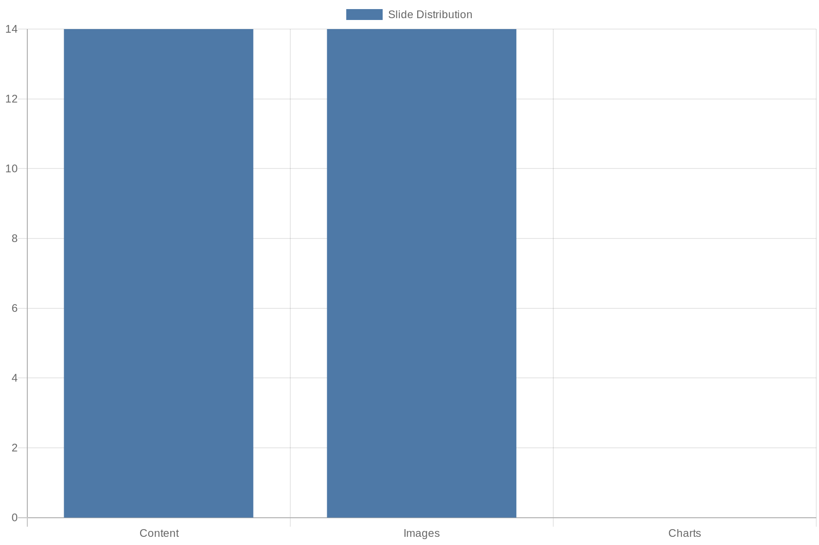
Visual Summary — Distribution

Slide 31
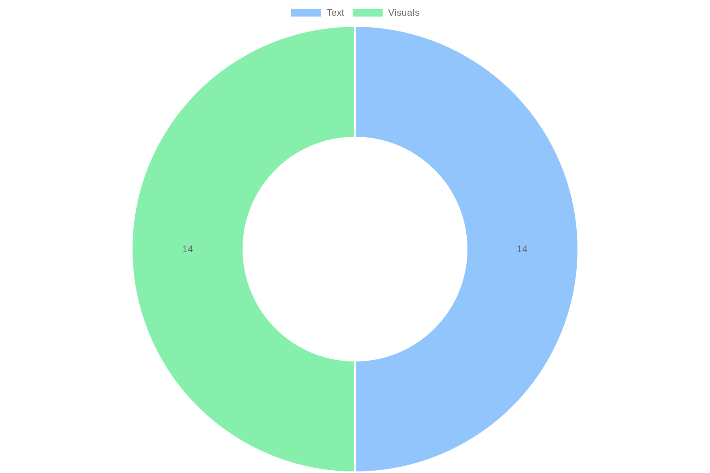
Visual Summary — Composition

Slide 32
References
https://www.vwbpe.org/cfp2025/presentation-guidelines
https://theusaleaders.com/articles/empowering-educators/
https://moreland.edu/resources/blog-insights/what-educators-predict-for-teaching-in-2025?category=school-leadership-resources
https://www.slideteam.net/top-10-teaching-powerpoint-presentation-templates
https://www.slideteam.net/top-10-education-transformation-powerpoint-presentation-templates
https://www.eduettu.com/post/what-to-watch-in-education-10-trends-shaping-2025
https://teachingtomorrow.co.uk/news/15-research-backed-teaching-best-practises-that-actually-work-2025/
https://www.jaroeducation.com/blog/ai-tools-for-ppt/
https://www.carnegielearning.com/blog/education-trends-for-2025
https://prezi.com/p/vvsdzgvece7j/education-2025-key-trends-shaping-the-future-of-teaching-and-learning/

